Slide 1
Convolutional Neural Networks (CNN)
Architecture, operations, and applications of CNNs — the backbone of modern computer vision.

Slide 2
Contents
01
02
What Are Convolutional Neural Networks?
Where are CNNs Applied?
03
04
The CNN Pipeline
Landmark CNN Architectures
05
06
Python Implementation
Key Takeaways

Slide 3
What Are Convolutional Neural Networks?
Convolutional Neural Networks (CNNs) are a specialised class of deep learning models designed primarily to process and analyse visual data such as images and video.
Unlike conventional neural networks, CNNs are built to understand spatial structure — they treat input as a grid of values rather than a flat vector.
Automatic Feature Learning
Hierarchical Representation
End-to-End Learning
CNNs learn to detect edges, textures, and complex shapes directly from raw pixel data — no manual feature engineering required.
Early layers capture simple patterns; deeper layers combine these into abstract, high-level representations like faces or objects.
From raw pixels to final class label, the entire transformation is learned from data, making CNNs both powerful and flexible.

Slide 4
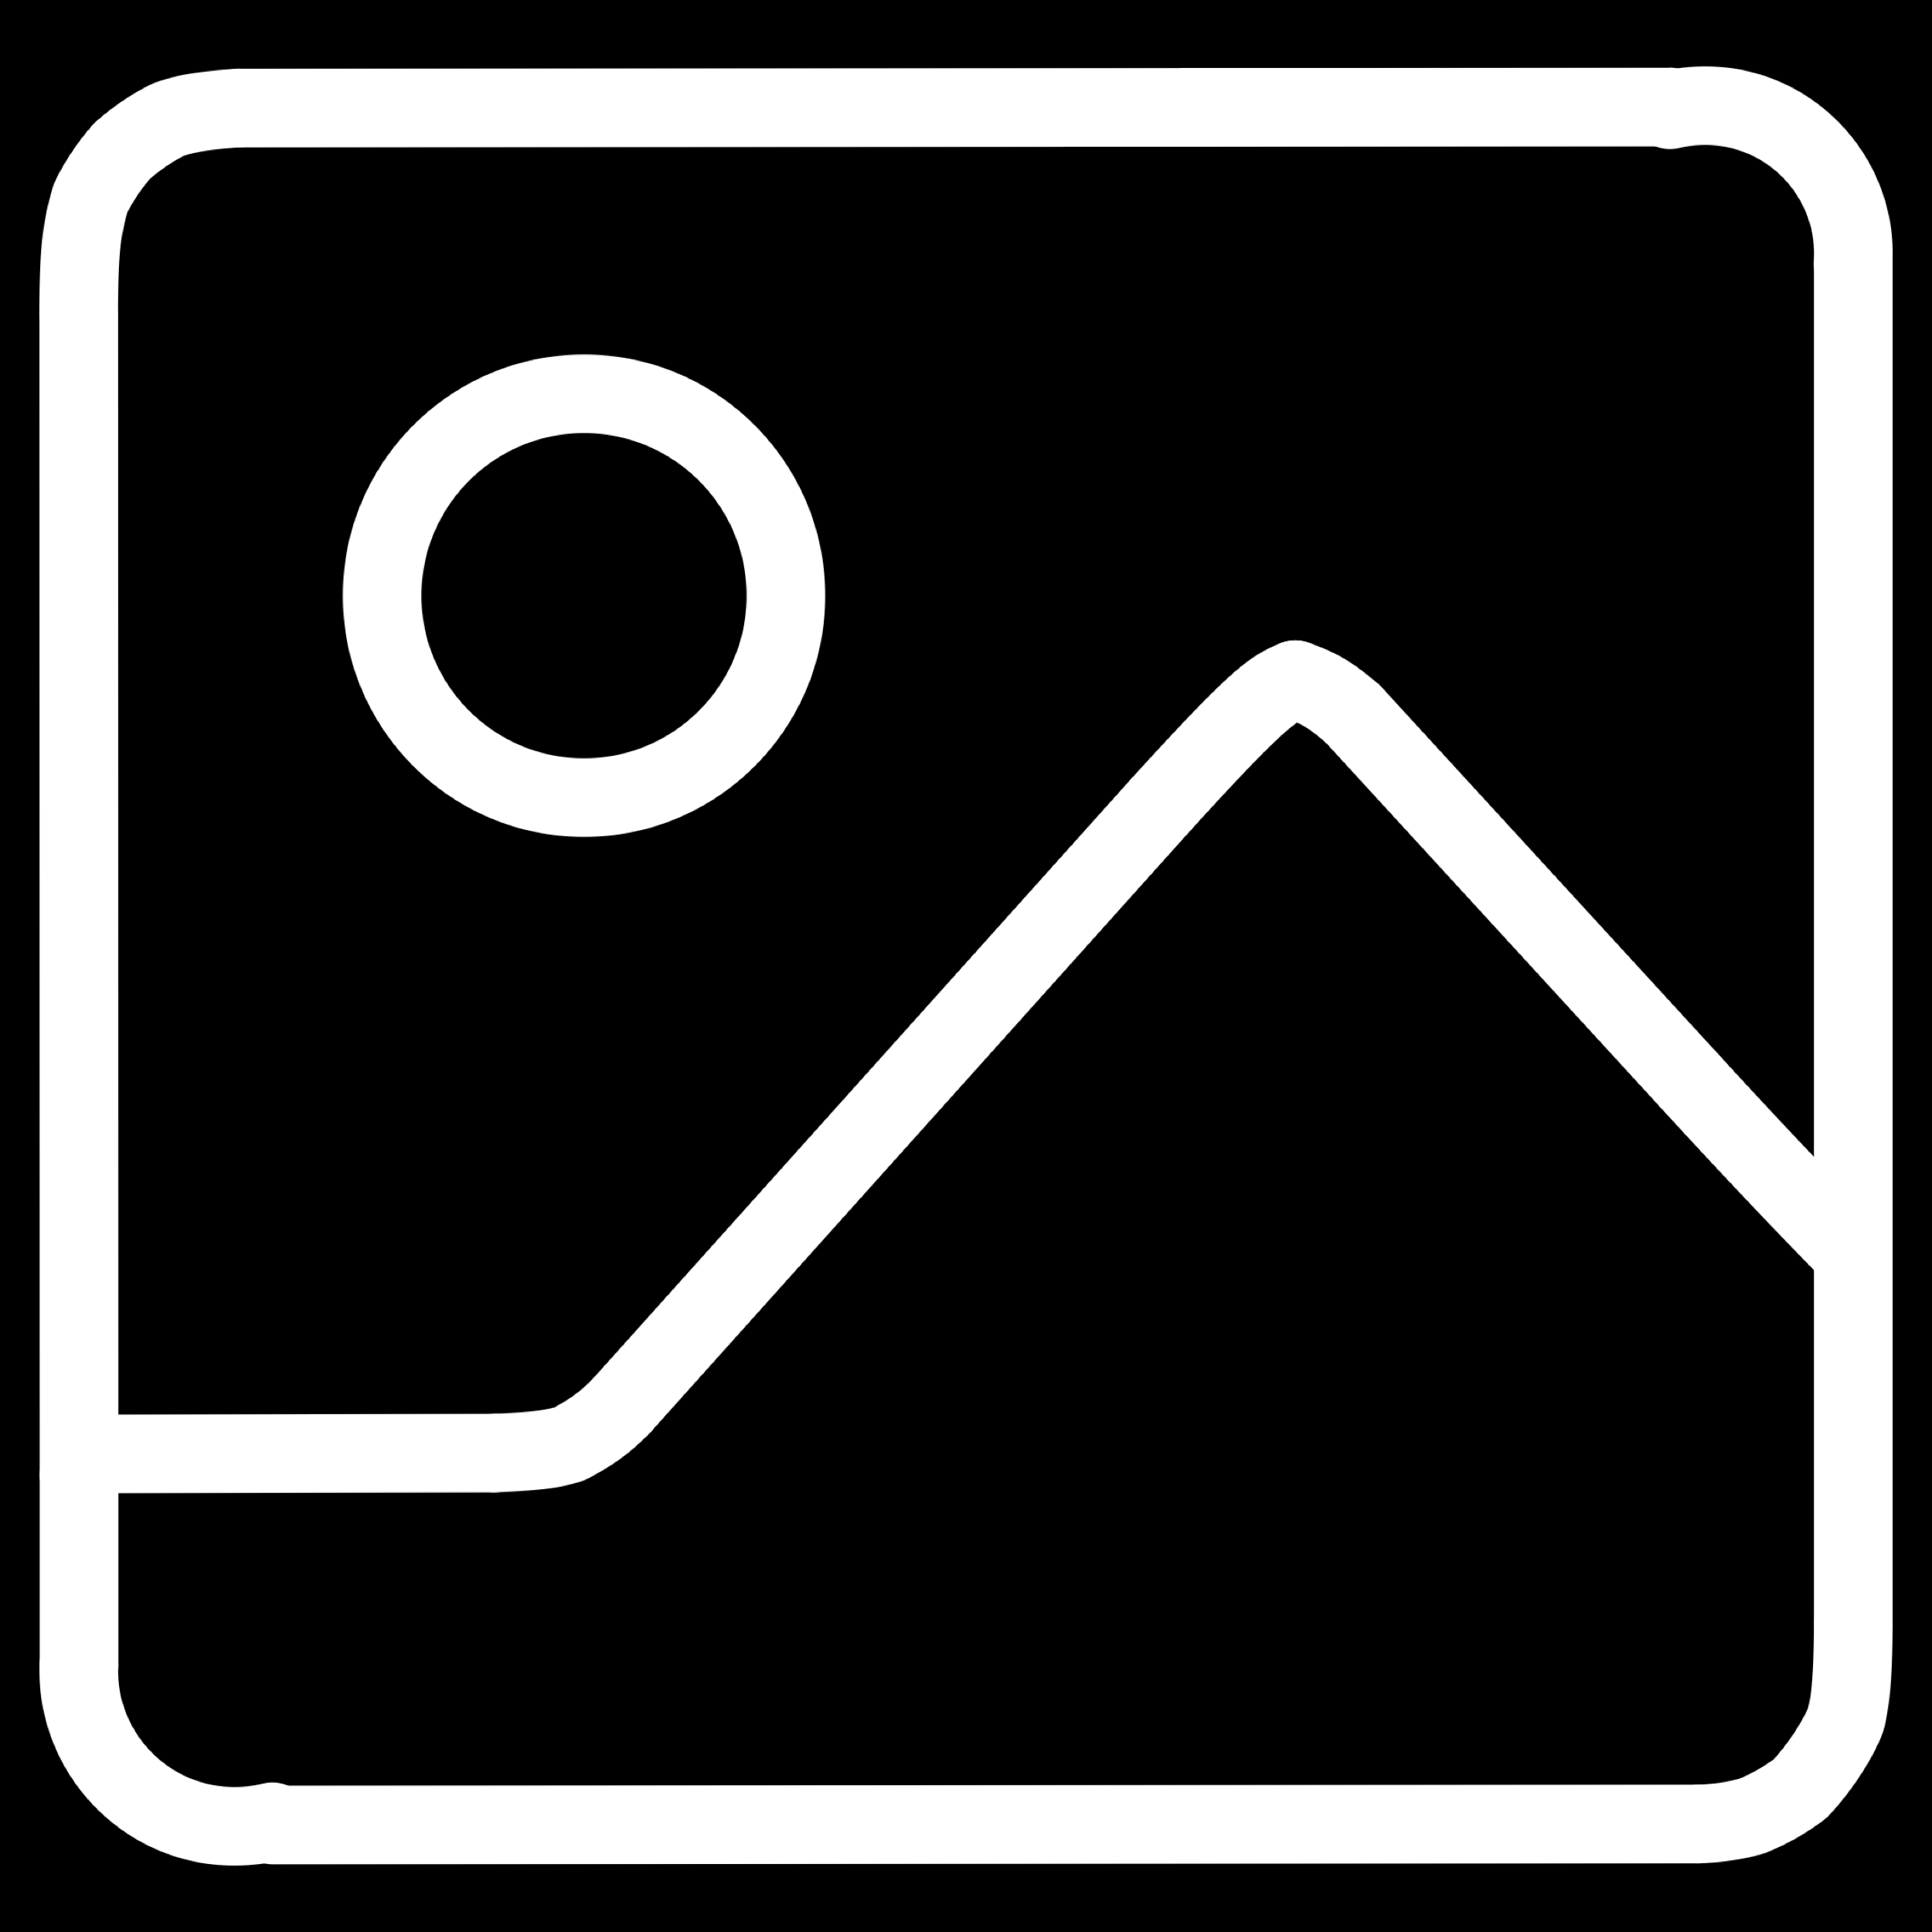
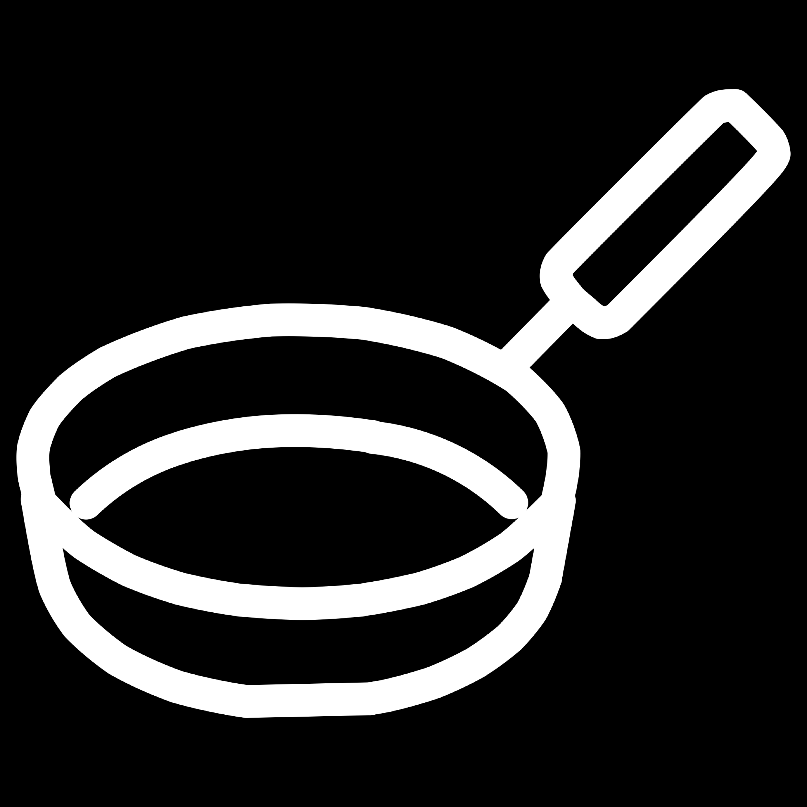
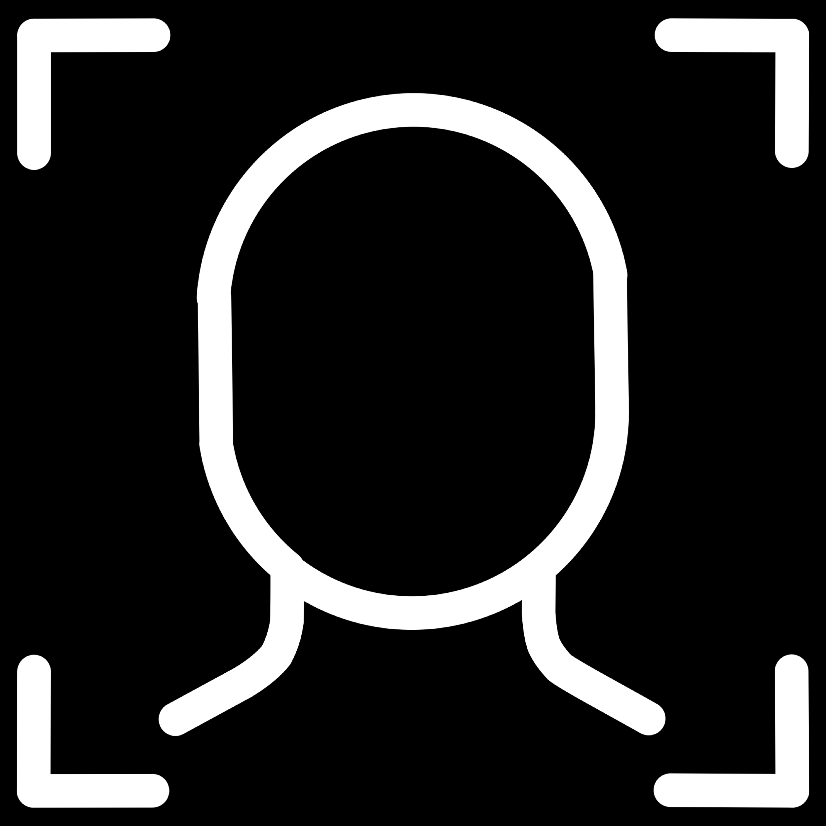
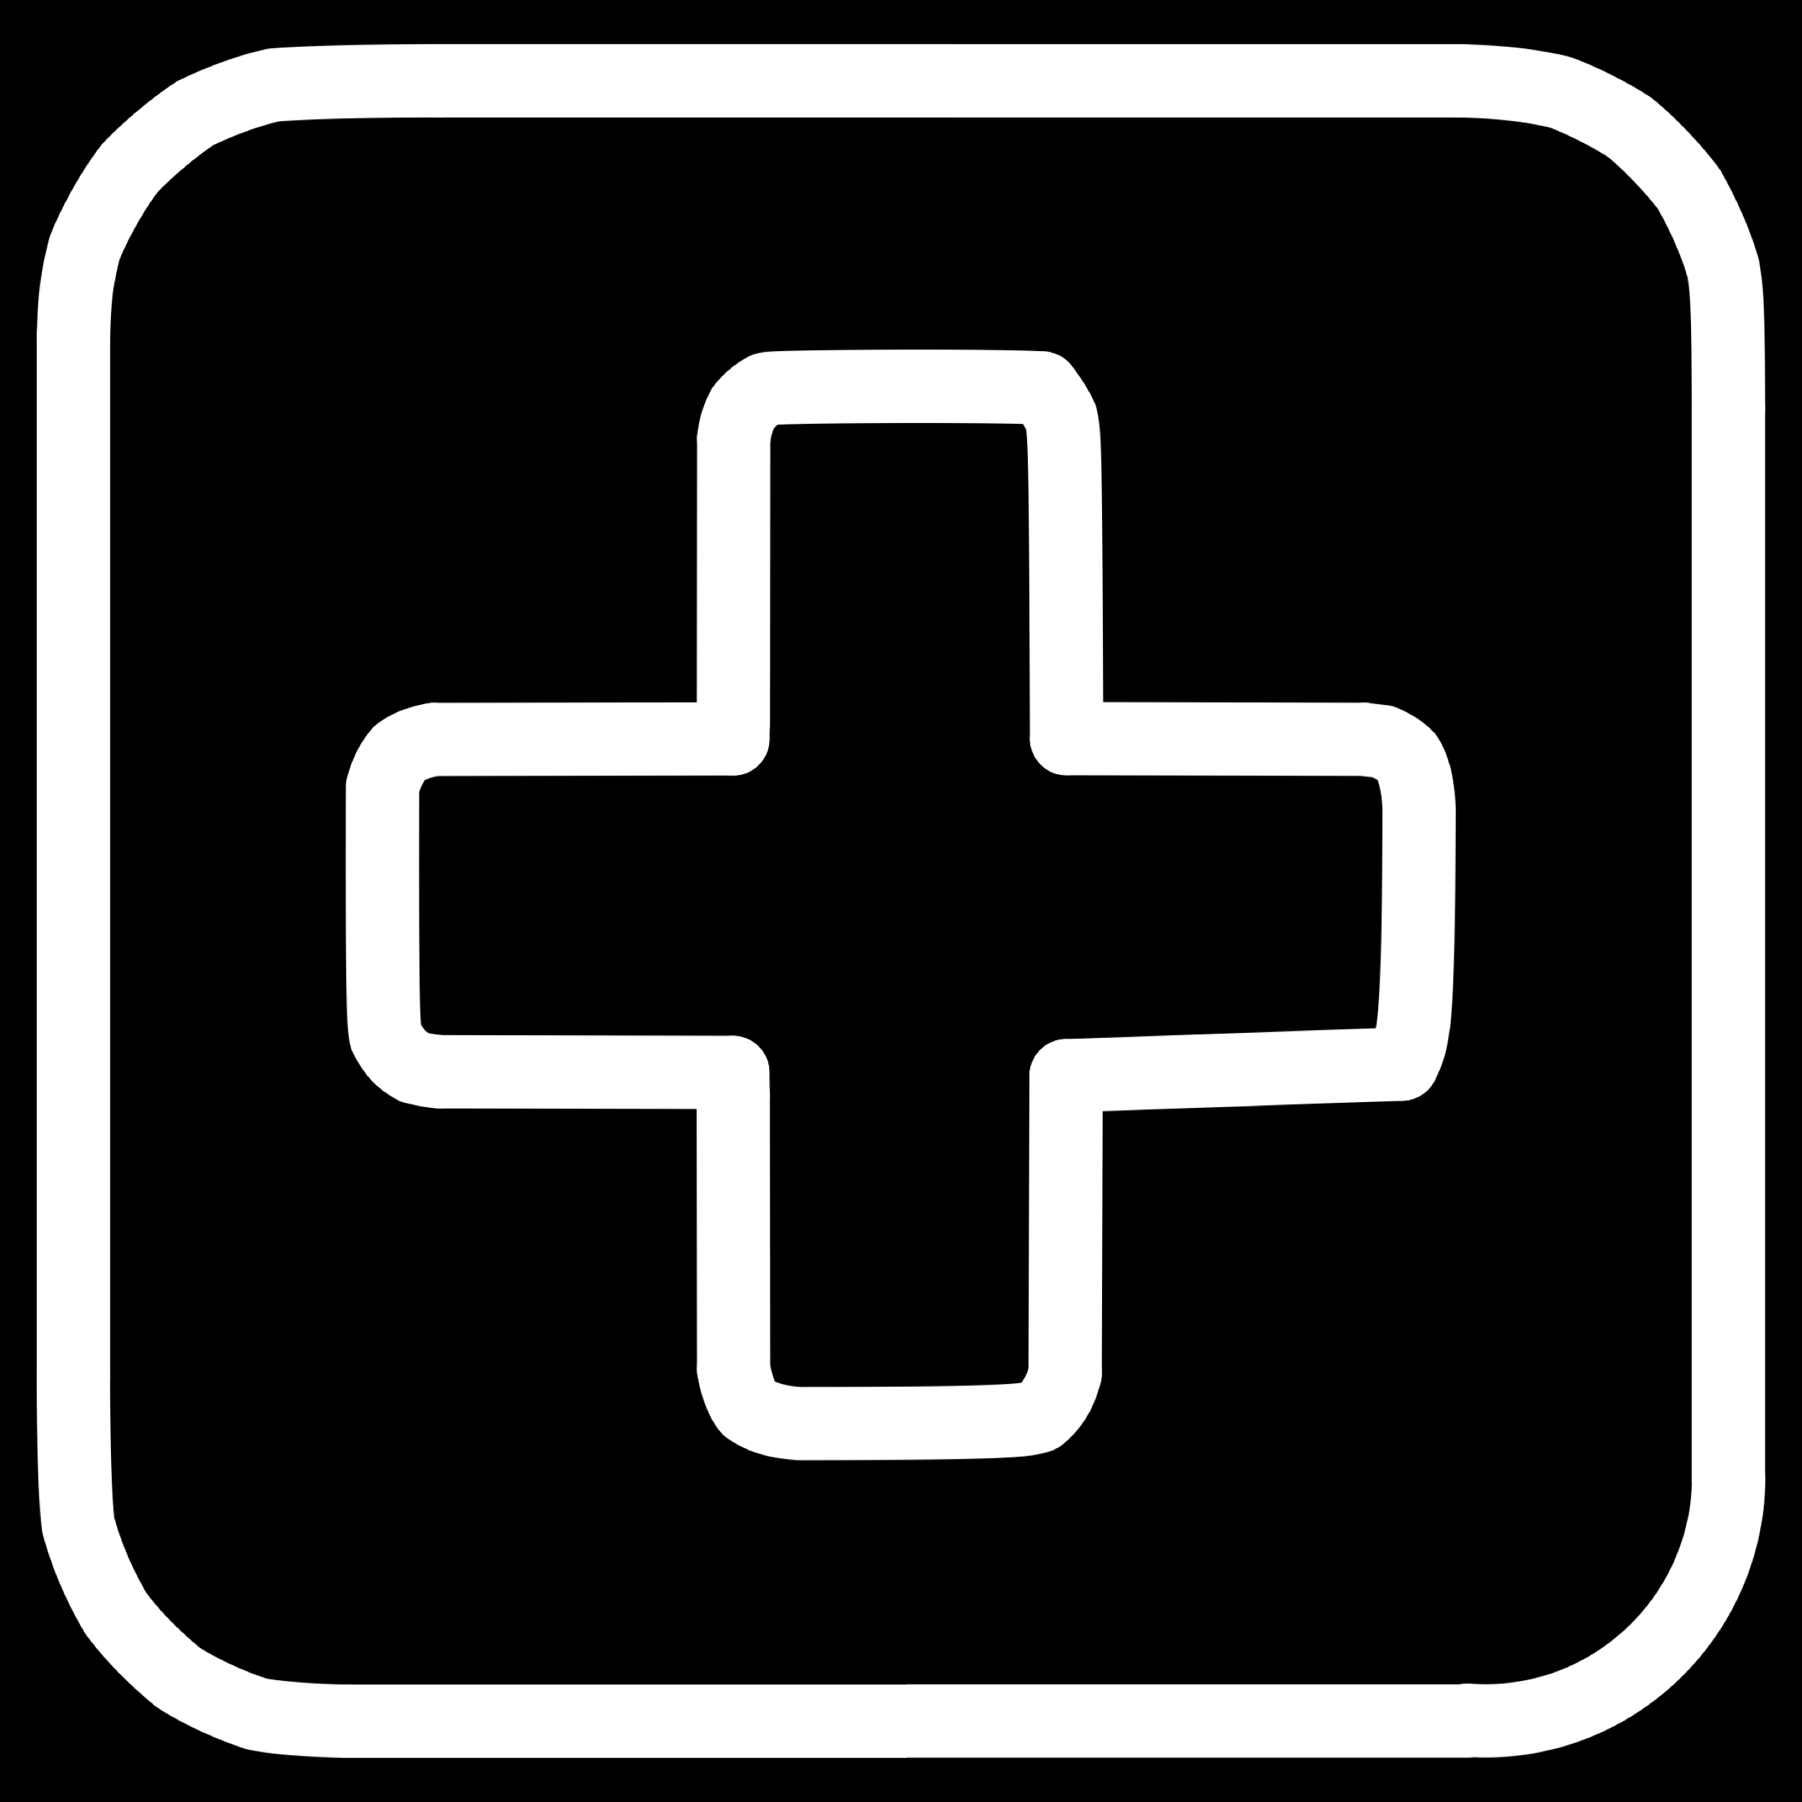
Where Are CNNs Applied?
CNNs have become the foundation of modern computer vision. Their ability to generalise across diverse visual tasks has made them indispensable in both research and industry.
Image Classification
Object Detection
Assigning a label to an entire image — e.g., "cat" or "dog".
Locating and identifying multiple objects within a single image.
Facial Recognition
Medical Imaging
Identifying or verifying individuals based on facial features.
Detecting diseases and anomalies in X-rays, MRIs, and CT scans.

Slide 5
Why Are CNNs Needed?
The Problem with Traditional ML
How CNNs Solve This
A 256×256 RGB image contains 196,608 raw pixel values. Feeding this into a standard fully connected network results in an enormous number of parameters, causing:
CNNs tackle high-dimensional image data by exploiting local connectivity and parameter sharing:
Filters operate on small local regions, drastically reducing parameters
Spatial structure is preserved throughout processing
Features are learned automatically from data
Hierarchical learning captures both fine details and global context
Severe computational overhead
Overfitting on small datasets
Loss of spatial relationships between pixels
Need for tedious manual feature extraction

Slide 6





Spatial Structure: The Key Insight
Traditional ML models flatten images into 1D vectors, destroying spatial relationships. CNNs preserve the 2D (or 3D) structure of images, allowing them to recognise that neighbouring pixels carry meaningful contextual information.
Raw Pixels
Local Patterns
High-dimensional numerical grid preserving spatial layout
Edges and gradients detected via localised filters
Spatial Features
Semantic Output
Textures and shapes built from combined local patterns
Abstract concepts like "eye" or "wheel" recognised automatically
Key Insight: Spatial locality — the idea that nearby pixels are more related than distant ones — is the fundamental assumption that makes CNNs work.

Slide 7
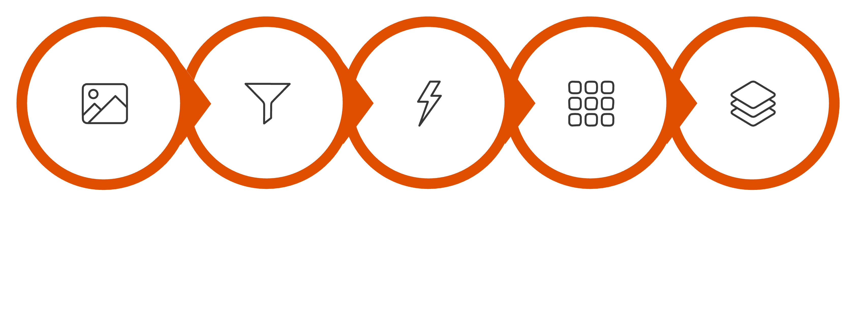





The CNN Pipeline
A CNN transforms a raw image into a class prediction through a series of structured operations. Each stage progressively learns
more complex and abstract features.
Fully Connected
Input Image
Convolution
ReLU
Pooling
This end-to-end pipeline enables the network to go from raw pixel values to confident class probabilities, with each intermediate stage building upon the representations learned by previous layers.

Slide 8
The Convolution Operation
Convolution is the mathematical core of every CNN layer. A small matrix called a filter (or kernel) slides across the input image. At each position, it performs element-wise multiplication with the overlapping image region, then sums the results to produce a single scalar value in the output feature map.
1
2
Position the Filter
Element-wise Multiply
The filter (e.g., 3×3) is placed over a local region of the input image or feature map.
Each filter value is multiplied by the corresponding pixel value in the overlapping region.
3
4
Sum and Record
Slide Across
All products are summed to produce one value, which is placed in the output feature map.
The filter slides across the entire input (determined by stride), repeating for every position.
The key advantage: the same filter weights are applied across the entire image — a property called parameter sharing — dramatically reducing the number of learnable parameters.

Slide 9
The Convolution Operation

Slide 10
Filters and Kernels
What Is a Filter?
Types of Features Detected
A filter (kernel) is a small matrix of learnable weights, typically 3×3 or 5×5. During training, the network adjusts these weights via backpropagation to detect features that minimise the loss.
Horizontal edge detectors — respond to horizontal intensity transitions
Vertical edge detectors — identify vertical boundaries in the image
Diagonal edges — capture angled contours and gradients
Texture filters — detect repeating local patterns
Blob detectors — highlight regions of uniform intensity
A single CNN layer contains multiple filters, each learning to detect a different pattern simultaneously.
Deeper layers combine outputs of earlier filters to detect eyes, wheels, or faces.

Slide 11

Stride
Stride defines how many pixels the filter moves at each step during convolution. It directly controls the spatial resolution of the output feature map and the computational cost of the operation.
Stride = 1
Stride = 2
Stride > 2
Fine-grained extraction. The filter moves one pixel at a time, producing a large feature map with high spatial resolution. Captures maximum detail but increases computation.
Downsampled output. The filter skips every other pixel, halving the feature map dimensions. Reduces computation and memory while still capturing dominant patterns.
Aggressive reduction. Used for rapid spatial compression. Less common in practice, but useful in certain architectures to replace pooling layers.
Output Size Formula: Output = ⌊(Input − Filter + 2×Padding) / Stride⌋ + 1

Slide 12
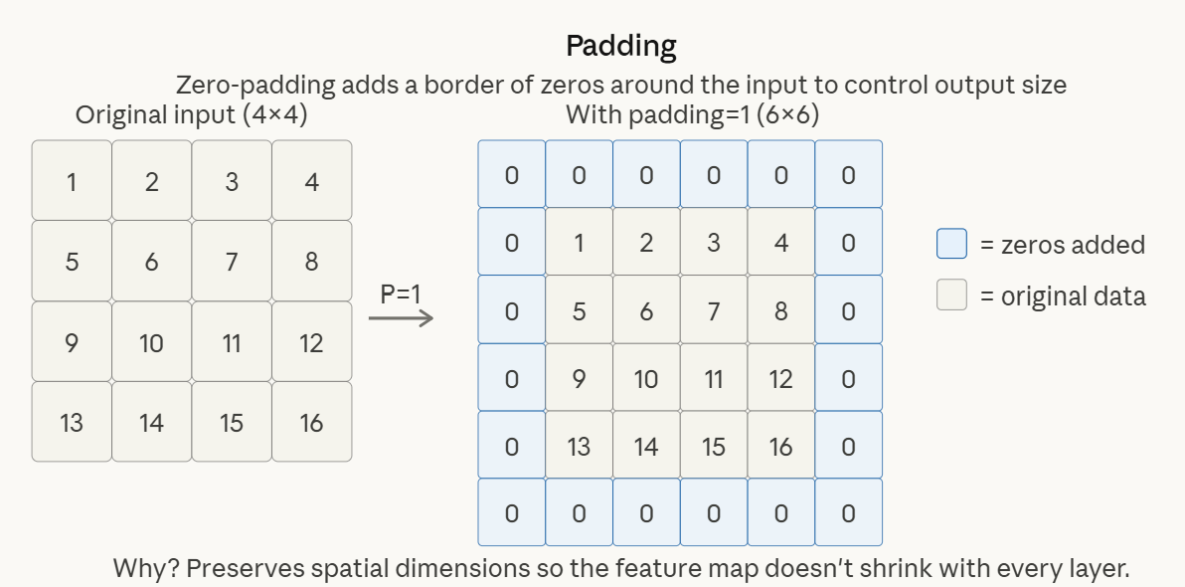
Padding
When a filter slides over an image, pixels at the border of the image are visited far fewer times than central pixels. Without padding, the spatial dimensions shrink after every convolution and border information is lost.

Slide 13
Padding
Padding ensures that all pixel positions — including those at the edges — contribute equally to feature learning, producing more complete and spatially balanced feature maps.
'Valid' Padding
'Same' Padding
No padding applied. The filter only operates within the original image boundaries. The output is smaller than the input — specifically by (filter size − 1) pixels in each dimension.
Zeros added around the border. Enough zero-pixels are added so that the output feature map has the same height and width as the input (assuming stride = 1).
Use case: When preserving spatial dimensions is critical, e.g., in deep architectures.
Use case: When dimensionality reduction after each conv layer is acceptable.

Slide 14


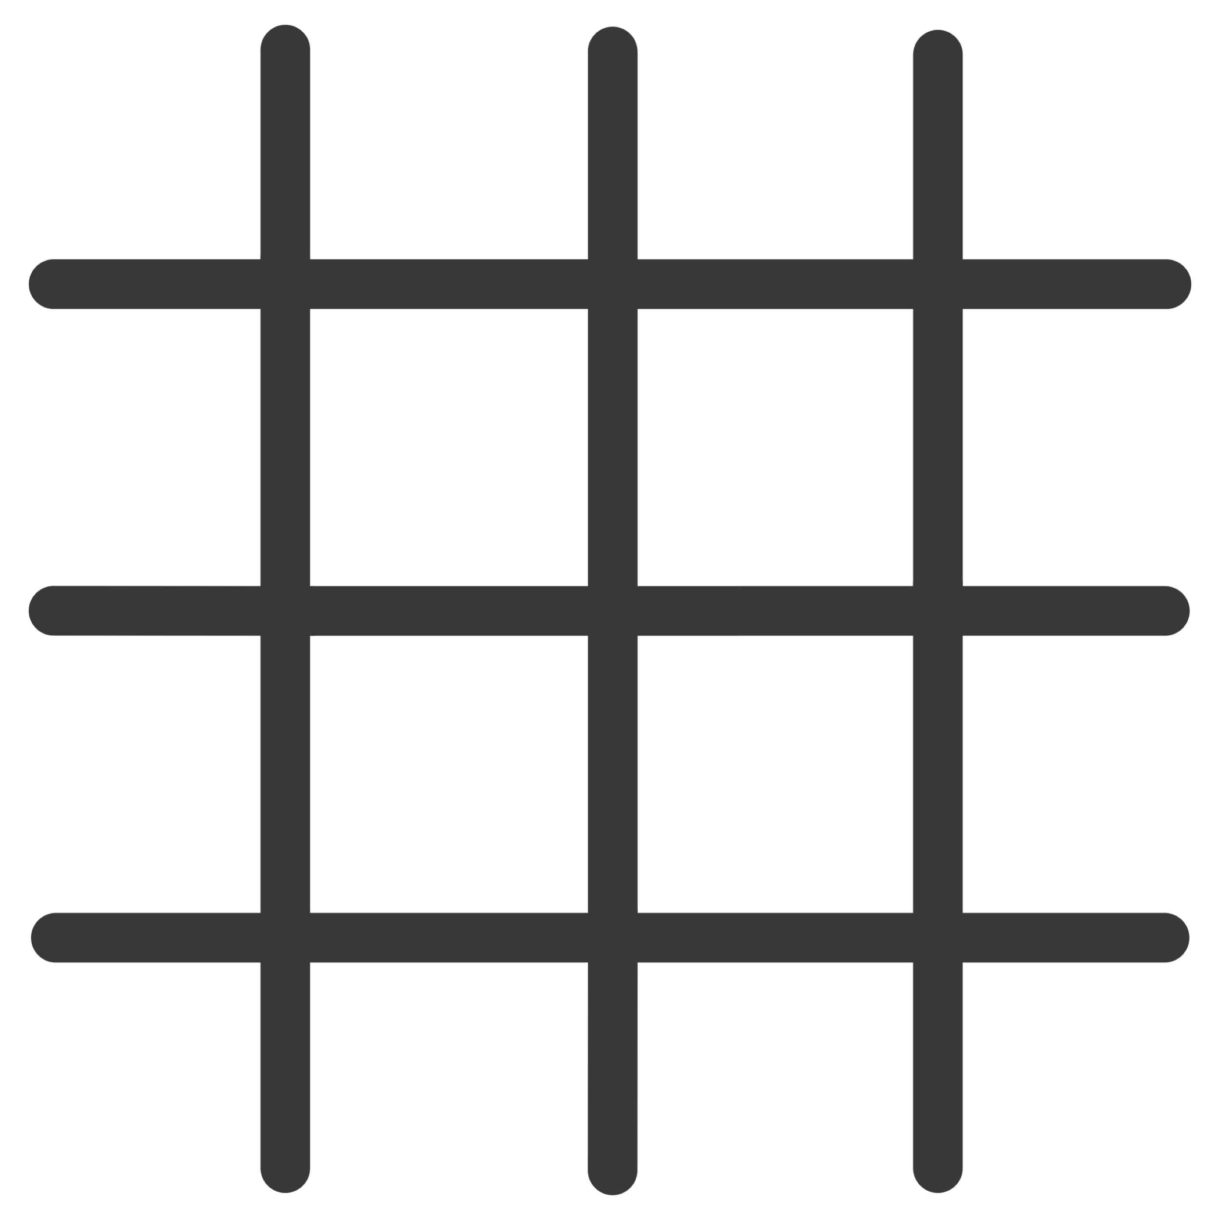
Feature Maps
A feature map is the output produced by applying a single filter across the entire input. Each feature map is a 2D matrix whose values indicate where and how strongly a particular pattern (e.g., a horizontal edge) is detected in the input.
Deep Layer Feature Maps
Layer 2–3 Feature Maps
Encode high-level semantic concepts: object parts (eyes, wheels, ears) and eventually full objects recognisable by the classifier.
Layer 1 Feature Maps
Combine outputs of earlier maps to detect mid-level features: textures, curves, and simple shapes like circles or lines.
Detect low-level features: edges, colour gradients, and simple corners. These are directly learned from the raw pixel input.

Slide 15
Activation Function: ReLU
After each convolution, an activation function is applied element-wise to the feature map. Without activation functions, the entire network would behave as a single linear transformation, no matter how many layers are stacked — fundamentally limiting its expressive power.
Rectified Linear Unit (ReLU)
Other Activation Functions
The most widely used activation function in CNNs. Its definition is elegantly simple:
Leaky ReLU: Allows a small gradient for negative values, preventing "dying ReLU" neurons.
Sigmoid: Maps output to (0,1) — useful for binary output layers.
All negative values are set to zero; positive values pass through unchanged. This introduces non-linearity while being computationally trivial to compute and differentiate.
Softmax: Converts logits to a probability distribution across classes — used in the final layer of classifiers.
Advantages of ReLU
Computationally efficient — no exponentials required
Mitigates the vanishing gradient problem in deep networks
Promotes sparsity — many neurons output zero

Slide 16
Pooling Layer
Pooling layers reduce the spatial dimensions (height × width) of feature maps while retaining the most salient information. By summarising local regions, pooling achieves translation invariance — the model remains responsive to a feature even if it shifts slightly in position.
Purpose
How It Works
Position in Pipeline
Reduce computational load for subsequent layers
Control overfitting through information compression
Build robustness to small spatial distortions
A window (e.g., 2×2) slides over the feature map with a defined stride. Within each window, a summary statistic is computed and recorded in the output. The result is a smaller, more compact feature map.
Pooling is applied after activation (Conv → ReLU → Pool). This sequence is the fundamental building block repeated throughout the CNN.

Slide 17
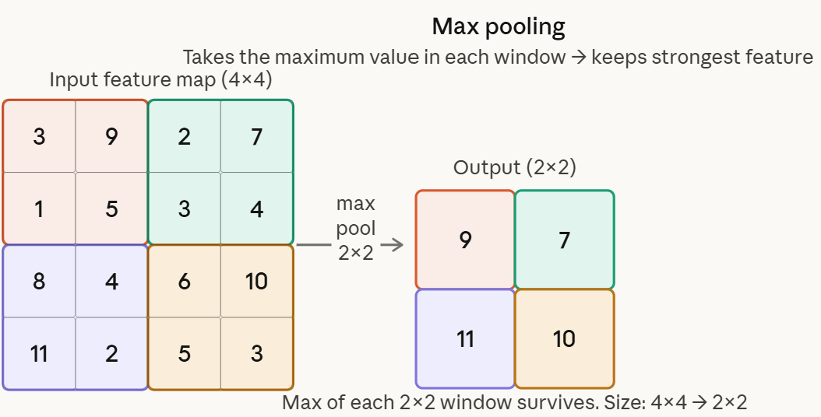
DIMENSIONALITY REDUCTION
Types of Pooling
Max Pooling
Selects the maximum value from each pooling window. This retains the strongest activation — the most prominent evidence that a particular feature is present in that region.
Most widely used pooling method
Effective for detecting whether a feature exists
Robust to small translations and distortions
Typical window: 2×2 with stride 2 (halves dimensions)
Practical Note: Max pooling is the default choice in most architectures. Global Average Pooling (GAP) is increasingly used in modern networks to reduce parameters and prevent overfitting.

Slide 18
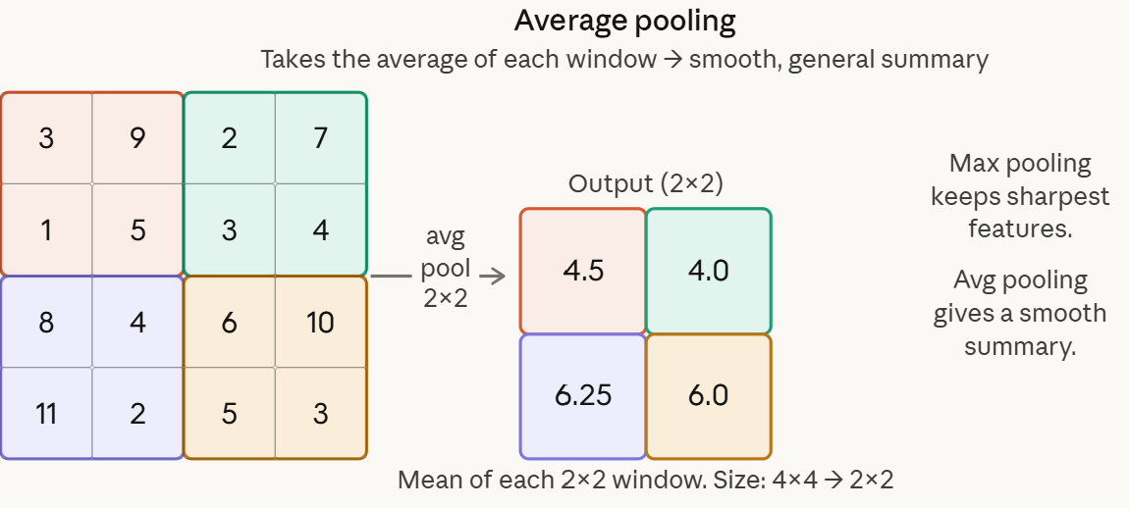
DIMENSIONALITY REDUCTION
Types of Pooling
Average Pooling
Computes the mean value across each pooling window. Produces a smoother, more distributed representation of the feature map by considering all activations equally.
Less aggressive than max pooling
Useful when global context matters more than peak activations
Common in final layers as Global Average Pooling (GAP)
GAP replaces fully connected layers in modern architectures

Slide 19
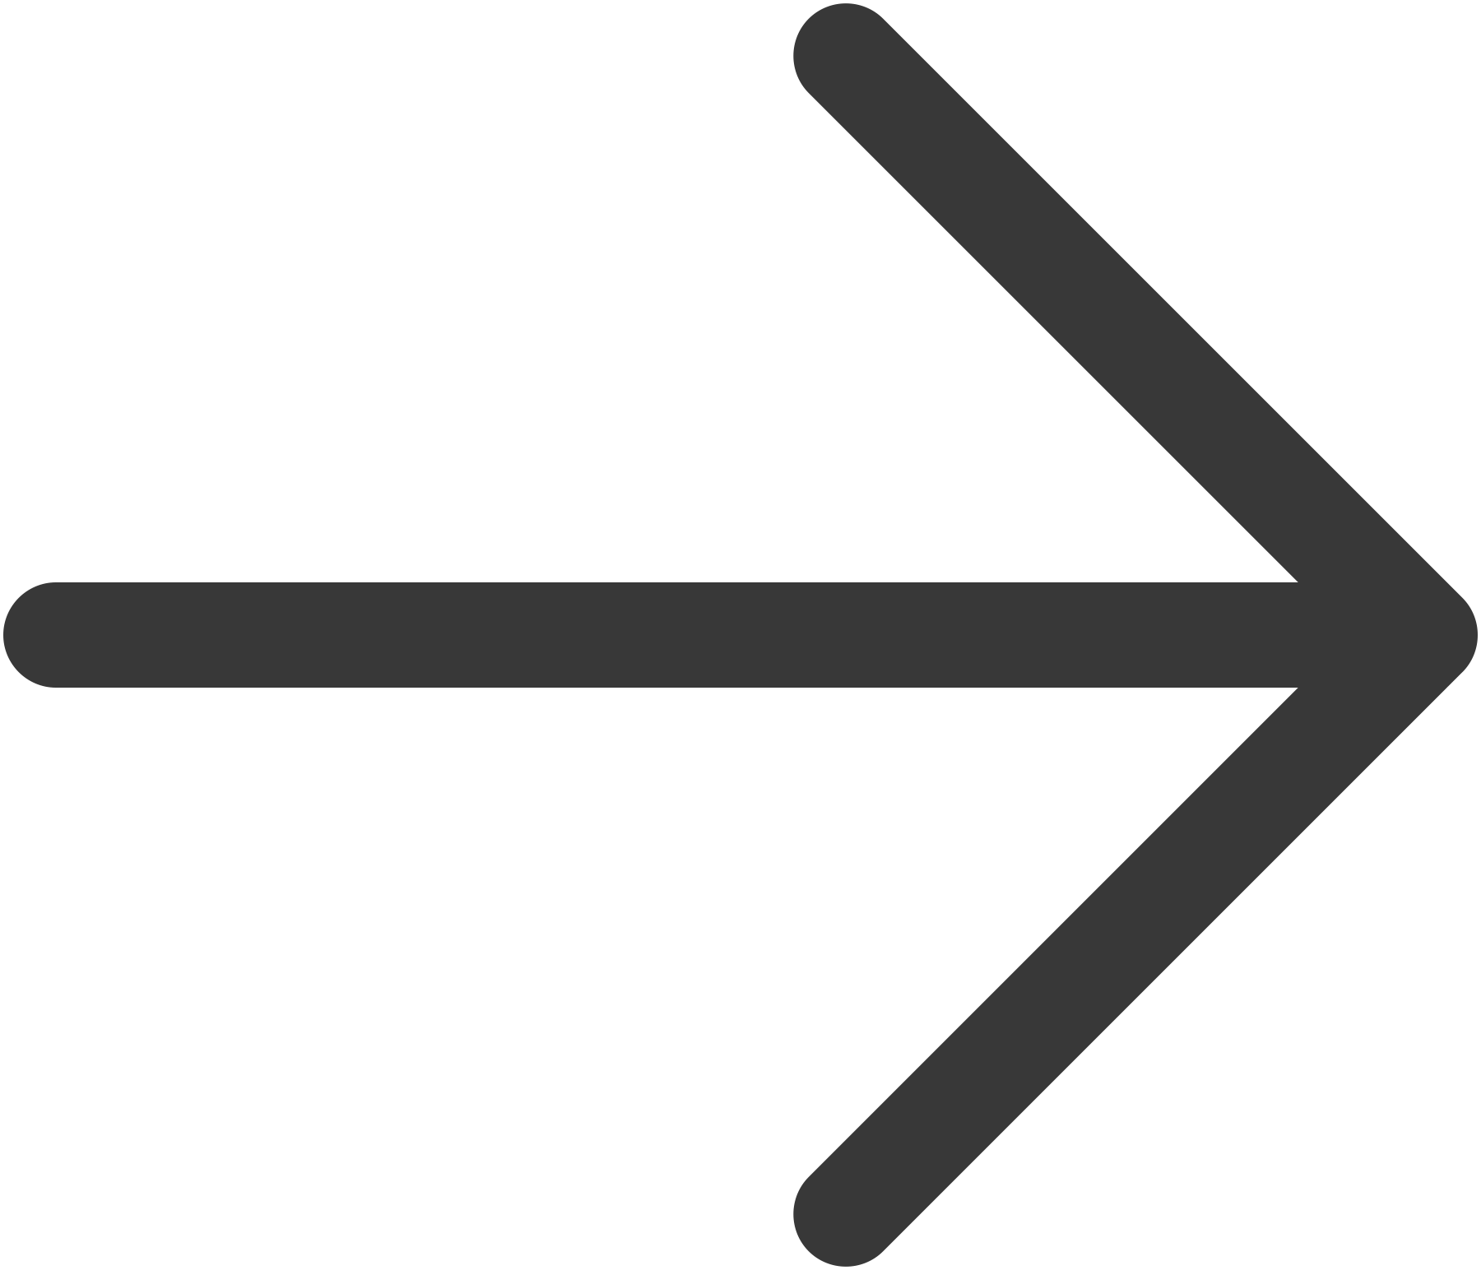
Fully Connected Layer
After a series of convolution, activation, and pooling operations, the spatial feature maps are flattened into a single 1D vector. This vector is then passed through one or more fully connected (dense) layers, where every neuron connects to every neuron in the adjacent layer.
Flatten
Dense Hidden Layer(s)
Output Layer
The final pooled feature maps (e.g., 4×4×64) are reshaped into a flat vector (e.g., 1024 values). This converts spatial representations into a format compatible with dense layers.
One or more fully connected layers with ReLU activation learn high-level combinations of the extracted features, capturing global relationships across the entire image.
The final dense layer produces one value per class. A Softmax activation converts these into a probability distribution — the model's confidence for each possible class label.

Slide 20
Landmark CNN Architectures
Over the past decade, several milestone architectures have driven dramatic improvements in computer vision benchmarks. Each introduced novel design principles that shaped subsequent research and deployment.
AlexNet (2012)
GoogLeNet (2014)
First deep CNN to win ImageNet. Introduced ReLU, dropout regularisation, and GPU training. Sparked the deep learning revolution.
Introduced Inception modules — parallel convolutions at multiple scales. Drastically reduced parameters while improving accuracy.
1
2
3
4
VGGNet (2014)
ResNet (2015)
Demonstrated that depth matters. Used very small 3×3 filters stacked deeply. Achieved state-of-the-art with 16–19 layers.
Introduced skip connections (residual blocks) to solve the vanishing gradient problem, enabling networks with 50–152+ layers.

Slide 21
Key Architectural Innovations
Each landmark architecture introduced a principle that is now considered standard practice in deep learning design.
Deep Stacking (VGG)
Multi-Scale Processing (Inception)
Residual Learning (ResNet)
Replacing large filters (e.g., 11×11) with stacked 3×3 filters achieves the same receptive field with fewer parameters and more non-linearities — improving both efficiency and accuracy.
Skip connections allow the gradient to bypass layers directly: . The network only needs to learn the residual , making very deep networks trainable.
Applying filters of different sizes (1×1, 3×3, 5×5) in parallel within the same layer allows the network to capture features at multiple scales simultaneously.

Slide 22
Implementing a CNN: Conceptual Overview
In practice, CNNs are implemented using high-level deep learning frameworks — primarily TensorFlow/Keras and PyTorch. These libraries abstract low-level operations, allowing practitioners to define complex architectures in a few lines of code.
Define Architecture
Compile Model
Stack Conv2D, MaxPooling, Flatten, and Dense layers using the framework's Sequential or functional API.
Select an optimiser (e.g., Adam), a loss function (e.g., categorical cross-entropy), and evaluation metrics (e.g., accuracy).
Train on Data
Evaluate and Predict
Feed labelled training images in mini-batches. The model updates weights iteratively via backpropagation over multiple epochs.
Assess performance on a held-out test set, then deploy the model to classify new, unseen images.

Slide 23
Sample Python Code: CNN in Keras
import tensorflow as tf
from tensorflow.keras import layers, models
# Build the CNN model
model = models.Sequential([
# Block 1: Convolution + Pooling
layers.Conv2D(32, (3, 3), activation='relu',
input_shape=(64, 64, 3)), # 64x64 RGB image
layers.MaxPooling2D((2, 2)), # Reduce spatial size
# Block 2: Convolution + Pooling
layers.Conv2D(64, (3, 3), activation='relu'),
layers.MaxPooling2D((2, 2)),
# Classifier Head
layers.Flatten(), # Convert 2D → 1D
layers.Dense(64, activation='relu'), # Fully connected layer
layers.Dense(10, activation='softmax') # 10 classes (multiclass classification)
])
# Compile the model
model.compile(
optimizer='adam', # Adaptive optimizer
loss='categorical_crossentropy', # For one-hot encoded labels
metrics=['accuracy'] # Evaluation metric
)
This TensorFlow / Keras model builds a simple CNN with two convolution + pooling blocks to extract features from 64×64 RGB images.
The flattened features are passed through dense layers to learn patterns and classify into 10 categories using softmax output.
It is compiled with Adam optimizer and categorical cross entropy loss to train efficiently and measure performance using accuracy.

Slide 24
Key Takeaways
Convolutional Neural Networks represent one of the most significant advances in modern machine learning. Below are the essential concepts from this unit.
1
CNNs Automate Feature Learning
2
The Core Pipeline is Structured
Unlike traditional ML, CNNs learn edges, textures, and shapes directly from raw pixels — eliminating manual feature engineering entirely.
Every CNN follows the same fundamental sequence: Conv → ReLU → Pool → Flatten → Dense → Softmax. Each stage has a precise role in transforming raw data into predictions.
3
Hyperparameters Control the Trade-offs
4
Architectures Keep Evolving
Stride, padding, filter size, and pooling type are design decisions that balance spatial resolution, computational cost, and model capacity.
From AlexNet to ResNet, each generation introduced innovations — deeper networks, residual connections, multi-scale filters — that continue to inform state-of-the-art models today.

